Slide 1
Set Data Structure

Slide 2
A set is a collection of objects need not to be in any particular order
It is just applying the mathematical concept in computer
Rules:
Elements should not be repeated
Each element should have a reason to be in the set

Slide 3
Example
Assume we are going to store football team player in a set.
The names should not be repeated, as well the name who is not in a team can’t be inserted.
This is the restriction we found in a set.

Slide 4
The set with no element is called null set or empty set.
For example:
A={x | x is a prime number, where 24 <x<29}
This set can’t contain a element. We don’t have any prime number within the limit 24 and 29.
a=set()
a.add(3)

Slide 5
Basic Operations
set union(set1,set2)
set intersection(set1,set2)
set difference(set1,set2)
int subset(set1,set2)

Slide 6
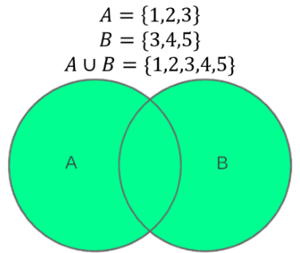
UNION
Combine two or more sets(here two sets), without violating the rules for set.
If you union two sets together, you get a new set containing all the members in each set (the green area in the Venn diagram)
a=set(‘1234')
b=set(‘3456')
union=a|b
{'2', '4', '3', '1', '6', '5'}

Slide 7
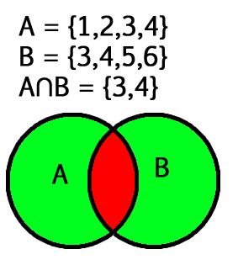
INTERSECTION
Gathering common elements in both the sets together as a single set.
The intersection of two sets is the set whose members exist in both sets. (the red area in the Venn diagram)
a=set(‘1234')
b=set(‘3456')
intersection=a&b
{'3', '4'}

Slide 8
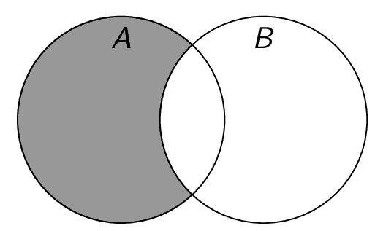
DIFFERENCE
Forming a set with elements which are in first set and not in second set.
A-B= {x| for all x belongs to A but not in B}
a=set(‘1234')
b=set(‘3456')
difference=a-b
{'2', '1'}

Slide 9
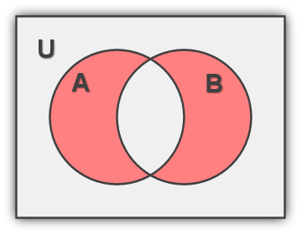
SYMMETRIC DIFFERENCE
The symmetric difference of two sets is defined as the set of all elements in either set but not in both sets.
A ∆ B = { x | x ∈ A - B or x ∈ B - A }.
a=set('1234')
b=set('3456')
symdif=a^b
print(symdif)
{'5', '2', '6', '1'}

Slide 10
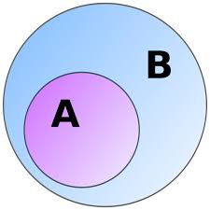
SUBSET
Returns True if the set1 is the subset of the set2.,otherwise False if not.
a=set('34')
b=set('3456')
t=a.issubset(b)
print(t)
A is subset of B
True

Slide 11
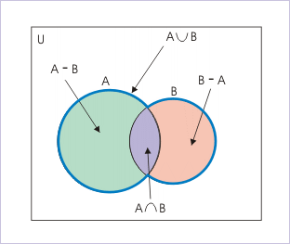
Set Basic Operations

Slide 12
Operations on Mutable Set ( Static Set)
• void* create(n) n=set()
• add(set , element); n.add(element)
• delete(set , element); n.remove(element)
• int capacity(set); len(n)

Slide 13
Exercise
Write a program in Python to execute the operations on mutable Set using array dataset ( list)
• void* create(n)
• add(set , element);
• delete(set , element);
• int capacity(set);

Slide 14
Operations on Immutable Set( Dynamic Set)
• int elementof(x , S)
• int empty(S)
• int size(S)
• void* build(x1 , x2 , … , xn)

Slide 15
ELEMENTOF
int elementof(type x , set set_name)
This function check for the element ‘x’ in the passed set.
Returns the value whether 0 or 1.
If the X is there in the set, return 1 otherwise 0.
b=set('3456')
t=False
if '3' in b:
t=True
print(t)

Slide 16
BUILD
void* build(set_elements)
This function create the set with the given elements and return the address of the first element.
a=set('11234')
list1=[12,435,67,21,56]
b=set(list1)
print("Set a: ",a)
print("Set b: ", b)
Set a: {'4', '1', '3', '2'}
Set b: {67, 12, 435, 21, 56}

Slide 17
Exercise
Write a program in Python to execute the operations on Immutable Set using array dataset ( list)
• int elementof(x , S)
• int empty(S)
• int size(S)
• void* build(x1 , x2 , … , xn)

